Slide 1
Introduction to Project Management
Definition of Project and Project Management
Triple Constraint of cost, time and quality
9 Knowledge Areas
Stakeholder Management
Project Life Cycle

Slide 2
Definition of Project and Project Management
A project is “a temporary endeavour undertaken to create a unique product, service, or result”

Slide 3
Attributes of Project
A project has a unique purpose
A project is temporary
A project is developed using progressive elaboration
A project required resources, often from various areas
A project should have a primary customer or sponsor
A project involves uncertainty

Slide 4
Advantages of project management techniques
Better control of financial, physical, and human resources
Improved customer relationships
Shorter development times
Lower costs and improved productivity
Higher quality and increased reliability

Slide 5
Advantages of project management techniques
Higher profit margins
Better internal coordination
Positive impact on meeting strategic goals
Higher worker morale

Slide 6
Project constraints
Every project is constrained in different ways, often by its scope, time, and cost goals
These limitations are sometimes referred to in project management as the triple constraint

Slide 7
Scope
What work will be done as part of the project?
What unique product, service, or result does the customer or sponsor expect from the project?
How will the scope be verified?

Slide 8
Time
How long should it take to complete the project?
What is the project’s schedule?
How will the team track actual schedule performance?
Who can approve changes to the schedule?

Slide 9
Cost
What should it cost to complete the project?
What is the project’s budget?
How will costs be tracked?
Who can authorize changes to the budget?

Slide 10
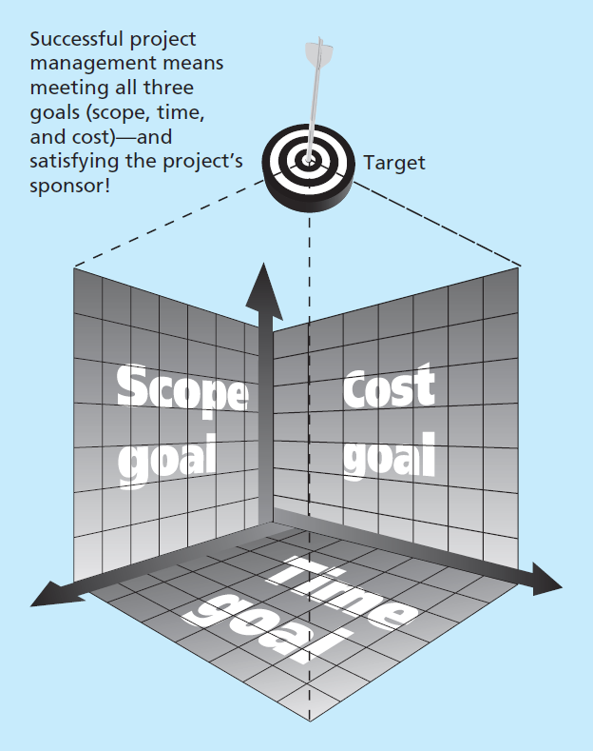
Project constraints
Successful project management means meeting all three goals (scope, time, and cost)—and
satisfying the project’s
sponsor!

Slide 11
What is a Project Management?
Project management is “the application of knowledge, skills, tools, and techniques to project activities to meet project requirements.”

Slide 12
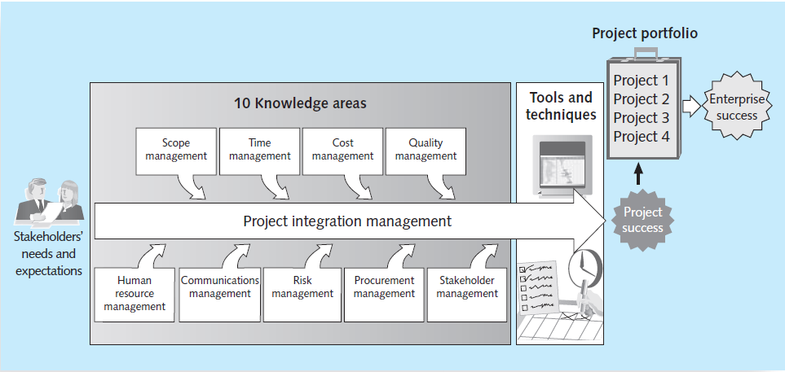
Project Management Knowledge Areas

Slide 13
Project Management Knowledge Areas
Project scope management involves defining and managing all the work required to complete the project successfully

Slide 14
Project Management Knowledge Areas
Project time management includes estimating how long it will take to complete the work, developing an acceptable project schedule, and ensuring timely completion of the project

Slide 15
Project Management Knowledge Areas
Project cost management consists of preparing and managing the budget for the project

Slide 16
Project Management Knowledge Areas
Project quality management ensures that the project will satisfy the stated or implied needs for which it was undertaken

Slide 17
Project Management Knowledge Areas
Project human resource management is concerned with making effective use of the people involved with the project

Slide 18
Project Management Knowledge Areas
Project communications management involves generating, collecting, disseminating, and storing project information

Slide 19
Project Management Knowledge Areas
Project risk management includes identifying, analyzing, and responding to risks related to the project

Slide 20
Project Management Knowledge Areas
Project procurement management involves acquiring or procuring goods and services for a project from outside the performing organization

Slide 21
Project Management Knowledge Areas
Project stakeholder management includes identifying and analyzing stakeholder needs while managing and controlling their engagement throughout the life of the project

Slide 22
Project Management Knowledge Areas
Project integration management is an overarching function that affects and is affected by all of the other knowledge areas

Slide 23
Project Stakeholders
Stakeholders are the people involved in or affected by project activities, and include the project sponsor, project team, support staff, customers, users, suppliers, and even opponents of the project

Slide 24
Project Stakeholders
Successful project managers develop good relationships with project stakeholders to understand and meet their needs and expectations.

Slide 25
Project phases and the project life cycle
A project life cycle is a collection of phases
In early phases of a project life cycle, resource needs are usually lowest and the level of uncertainty is highest

Slide 26
Project phases and the project life cycle
Each phase of a project should be successfully completed before the team moves on to the next phase
In the concept phase, managers usually develop a business case, which describes the need for the project and basic underlying concepts

Slide 27
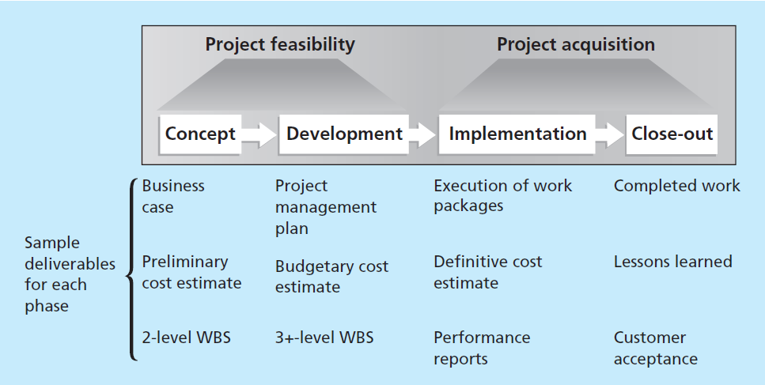
Project phases and the project life cycle

Slide 28
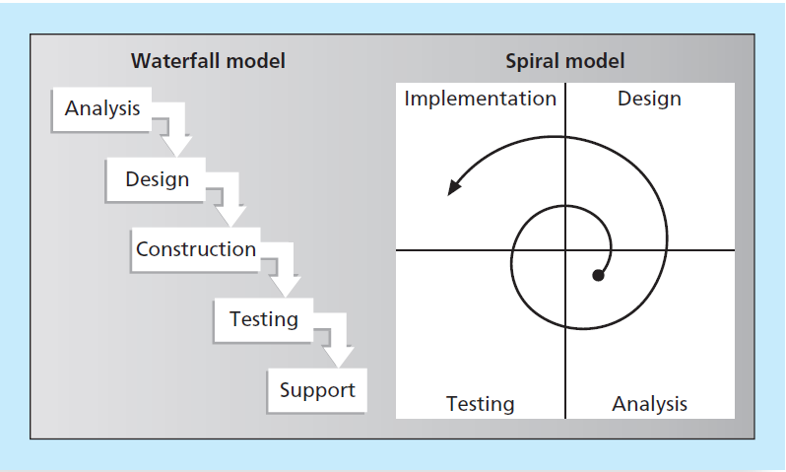
Project phases and the project life cycle

